Slide 1
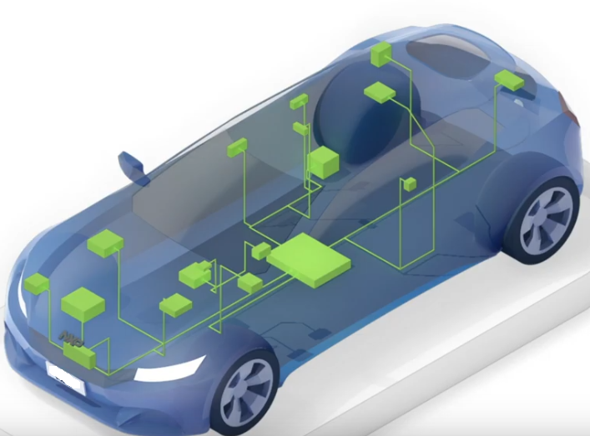
Company Presentation
leadembeddedsystems@gmail.com
August 2024

Slide 2
Index
About Us
Who We Are
What We Do
Projects
Software Tools
Hardware Tools

Slide 3
About Us
Lead Embedded is a start up company started in June 2021 near Uppal Telengana.
Lead Embedded is specialized in
Firmware development for CAN(Controller Area Network protocol, EOL (End Of Line) tools using
UDS (Unified Diagnostic Services) and OBD2 (On Board Diagnostic) protocols for Automotive Vehicles.
Control of BLDC and PMSM motors using FOC (Field oriented Control).
Firmware development for the Microcontroller based Embedded Application.
Hardware Schematic design for the Microcontroller based Embedded Applications.
Wiring harness design using Siemens Software.

Slide 4
What We Do
Firmware Development for Board Support Packages and Application
BSP (Board Support Packages) will be developed for any micro controller and customized based on requirement.
The below BSP are developed for the Microchip 16 bit family Micro controllers.
a. Microcontroller Clock - Driver to initialize the micro controller Clock at different clock frequencies
b. Sleep and Wakeup Module – The sleep and wakeup drivers implemented for power saving when the
module is not active,
c. Digital (DIO) Module - Software module to read the digital input and control the digital outputs.
d. Analog (ADC) Module – Software Module to read the Analog input with 12 / 10 bit ADC.
e. Timer Module – Software module to initialize the timer for 1ms, this is the basic OS scheduler.
f. CAN – Software module to perform the CAN communication used in Automotive applications.
g. UART – Module to perform the serial communication.
h. SPI - SPI drivers to read and write data into EEPROM memory to store non volatile memory.
The Application Software on microcontroller platform will be developed based on the requirement.

Slide 5
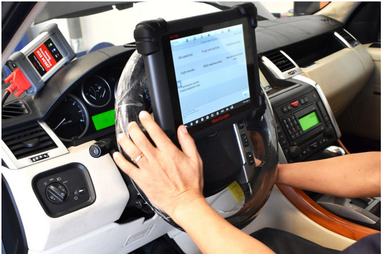
EOL / UDS / OBD2 Software Development
Software development for UDS and OBD2 protocols for EOL (End of Life) tools
using CAN (Controller Area Network).
CAN driver development and CAN TP protocol development.
UDS protocol developed and tested for the following below services
a. Default, Programming, Extended Sessions. (0x10 service)
b. Read By Data Identifier ( 0x22)
c. Write By Data Identifier (0x2E)
d. DTC logging (0x29 Service)
e. Clear DTC (0x14 Service)
f. Flashing using UDS protocol. (0x36 Service)
OBD2 services implementation.
EOL hardware tool development to include the Keypad and Graphical
display.

Slide 6
Motor Controller Software Development
Motor control software development for PMSM motors using FOC.
Motor Control software development using Trapezoidal switching.
Evaluation board MCLV-2 board from Microchip (dspic33EV family) is used for driving the motor.
PMSM 2KW motor with Digital Hall sensor and Encoder is driven in open loop conditions.
MOTOR CONTROLLER
PMSM Motor
Torque Command
R
12V section
Power
Section
Y
B
Position Sensor
Rotor Position

Slide 7
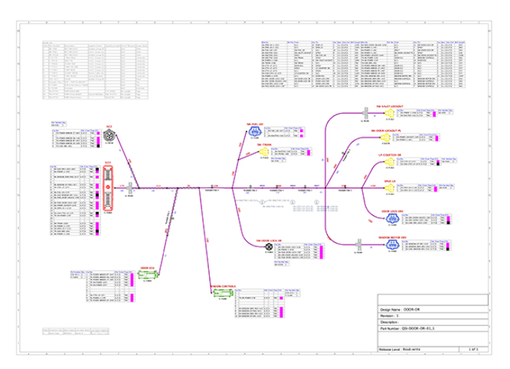
Wiring Harness Design
VeSys Harness software is used for creating harness and
formboard drawings.
Development using VeSys software with automated parts selector to configure and select terminals, wires, for each connector.
Reporting capabilities to generate documentation for manufacturing.
Reduce production lead times
Prevent manufacturing errors.

Slide 8
Software Tools / Expertise
PC-lint Plus static analysis software for C used for MISRA Checking.
Astyle – Artistic Style source code Indenter, formatter, and source code beautifier
MPLABX microchip Compiler IDE.
Microchip CAN Bus Analyzer Software.
Experience on Microchip, NXP, Infineon micro controller architectures.

Slide 9
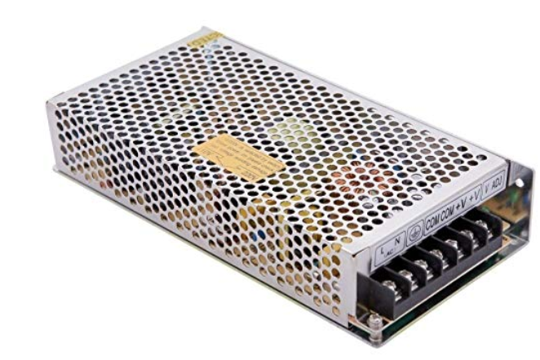
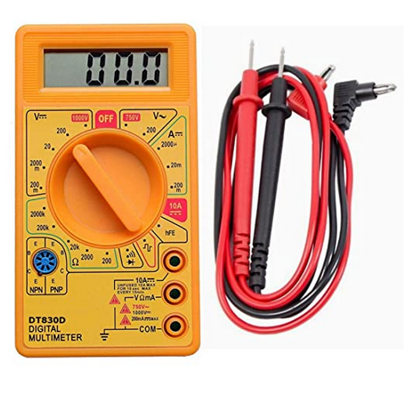
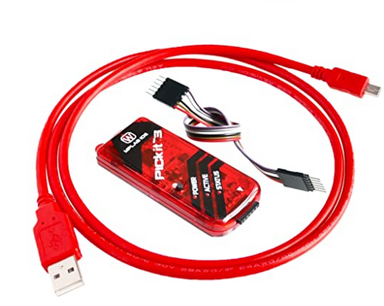
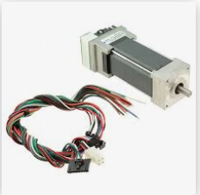
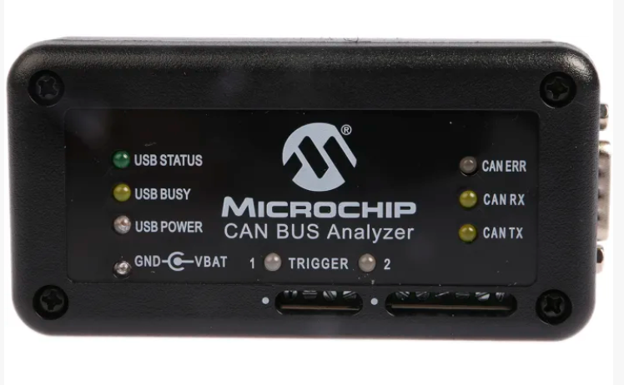
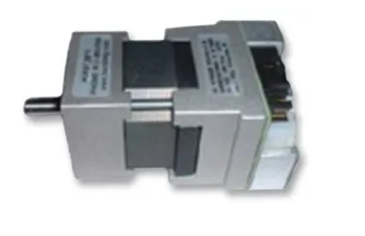
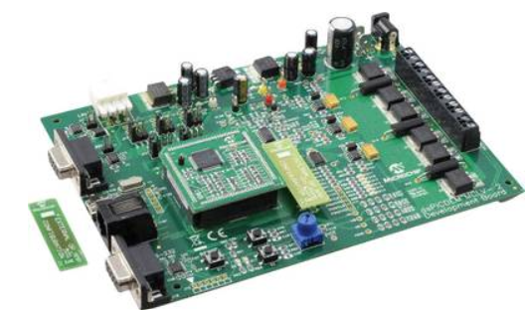
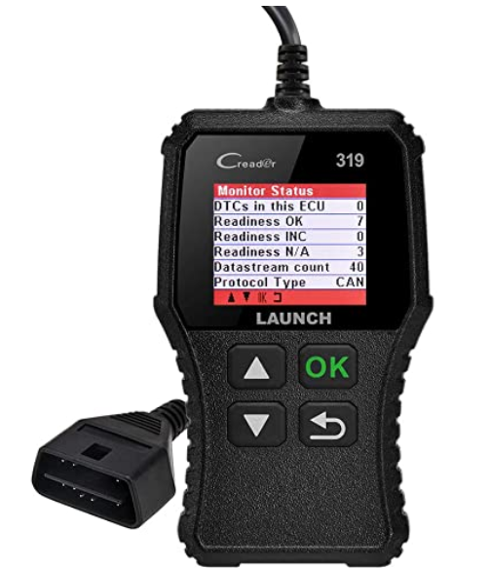
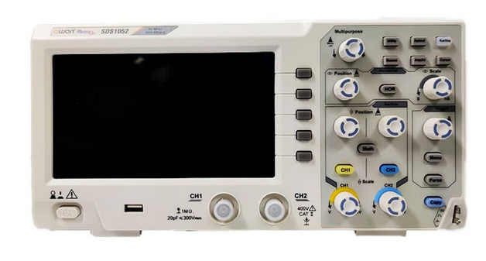
Hardware Tools
XONIER 12V 10Amp
120W DC Power Supply
DT830D LCD Display Digital Multi-meter
PICKit3 Programmer
Simulator for Microchip
24V 3-Phase Brushless DC Motor, Encoder
Microchip CAN Bus Analyzer
24V 3-Phase Brushless DC Motor, Hall Effect Sensors
MCLV-2 Dev Board
Owon MetroQ 2 Channel SDS1052
Digital Storage Oscilloscope 50 MHz
Full OBD2 Functions CAN Diagnostic Scan Tool

Slide 10
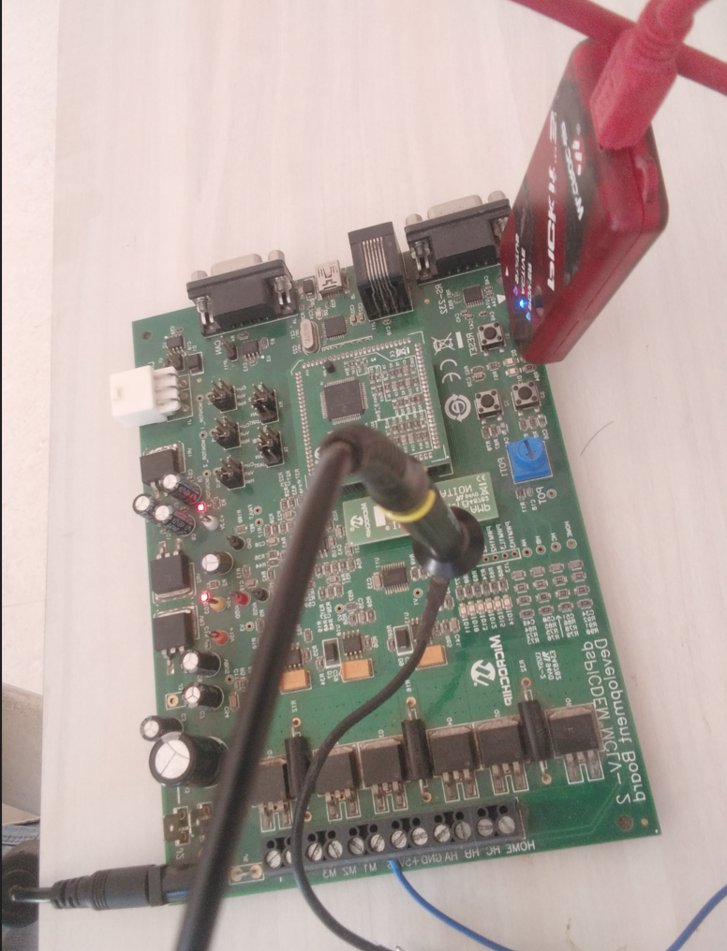
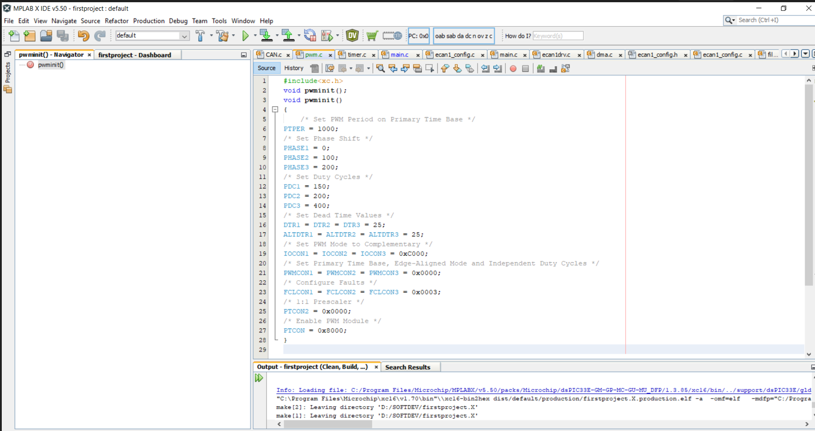
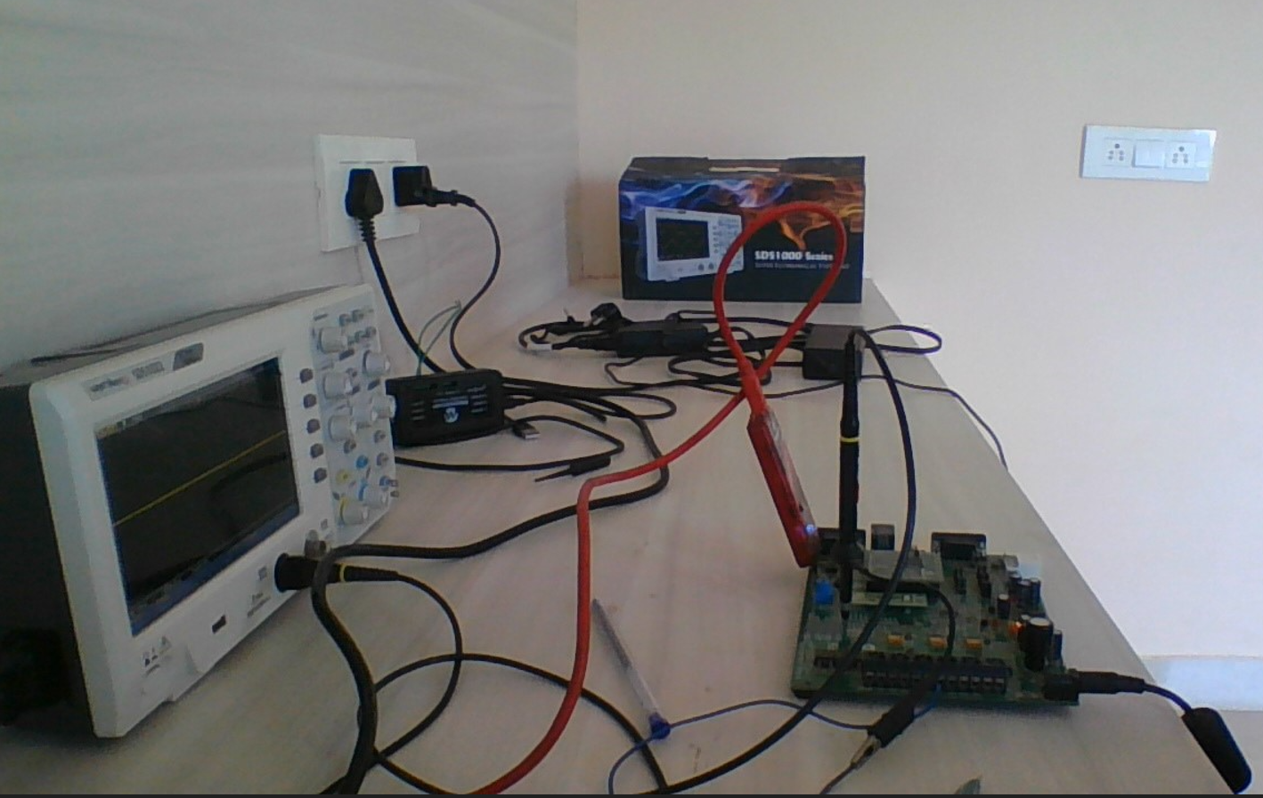
Lab Setup
Software Flashing: The software is flashed using the Pickit3 programmer.
The compiler used is MPLABX for programming and flashing C programs.
Flashing Using Pickit3
MPLABX Compiler C programme
Complete Setup

Slide 11
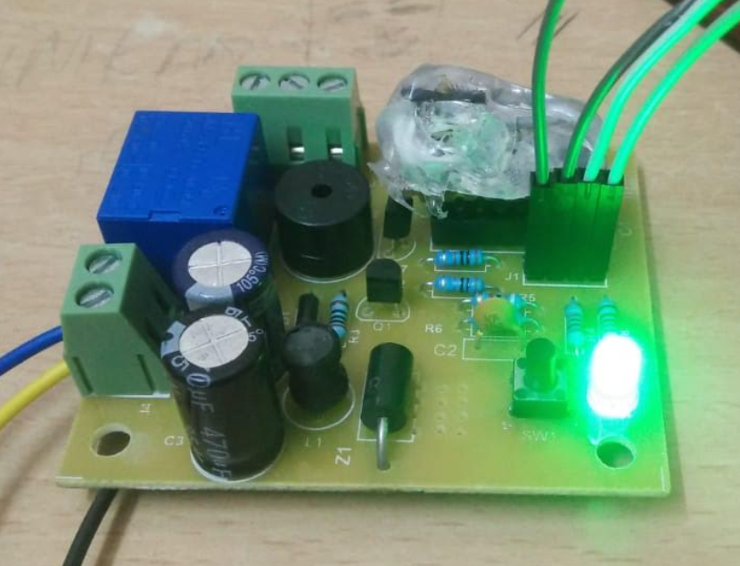
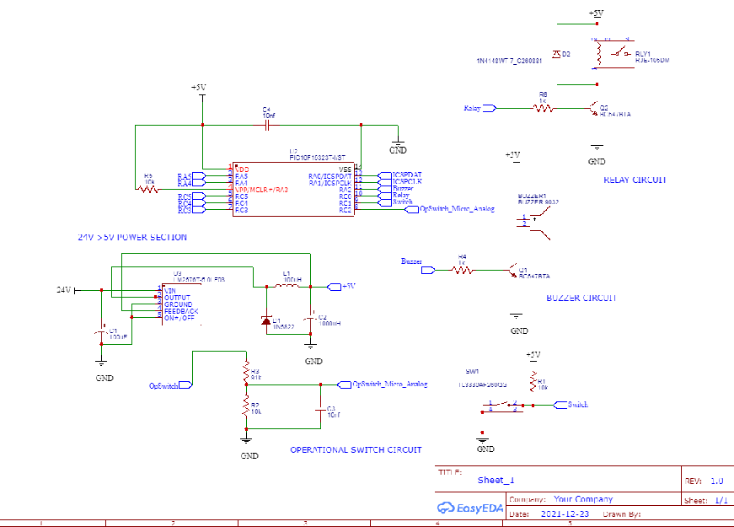
Projects
Buzzer / Relay Project
The project is storing and calculating the number of hours the operational switch is ON and then switching ON Buzzer and Relay.
Scope of Project: Proto Concept Development of the Hardware and Software.
Micro : PIC Microcontroller.
Software Modules Developed:
Internal clock for 20MHz
ADC Module for checking the voltage and taking a decision
if the operational switch is ON / OFF
Digital Module to interface the switch to reset the number of
hours.
NVM Memory for storing the number of hours the operational
switch is ON.
Hardware Schematic Design:
EasyEDA software used for schematic design.

Slide 12
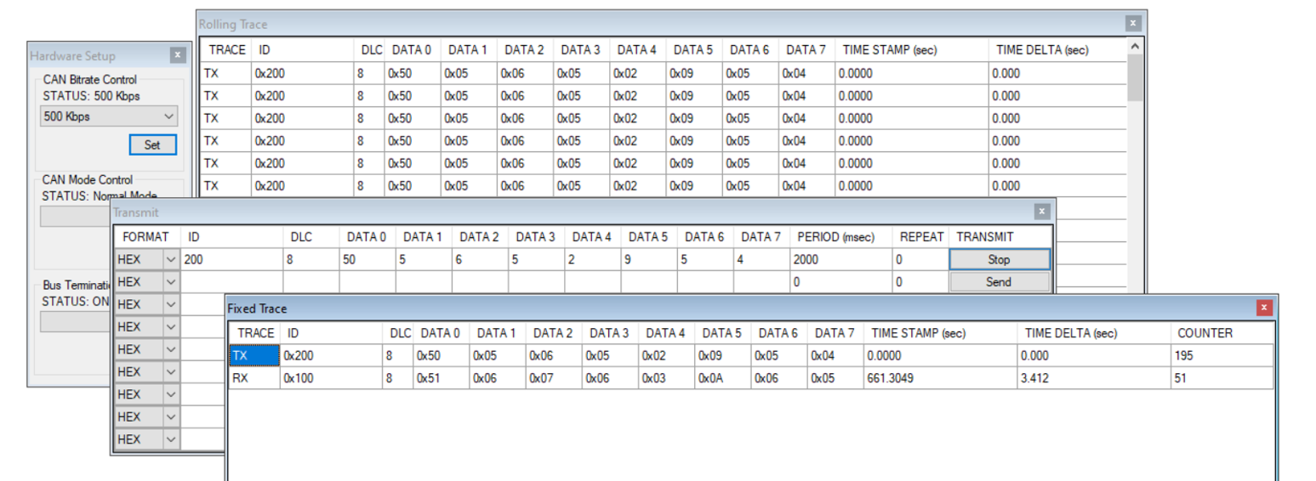
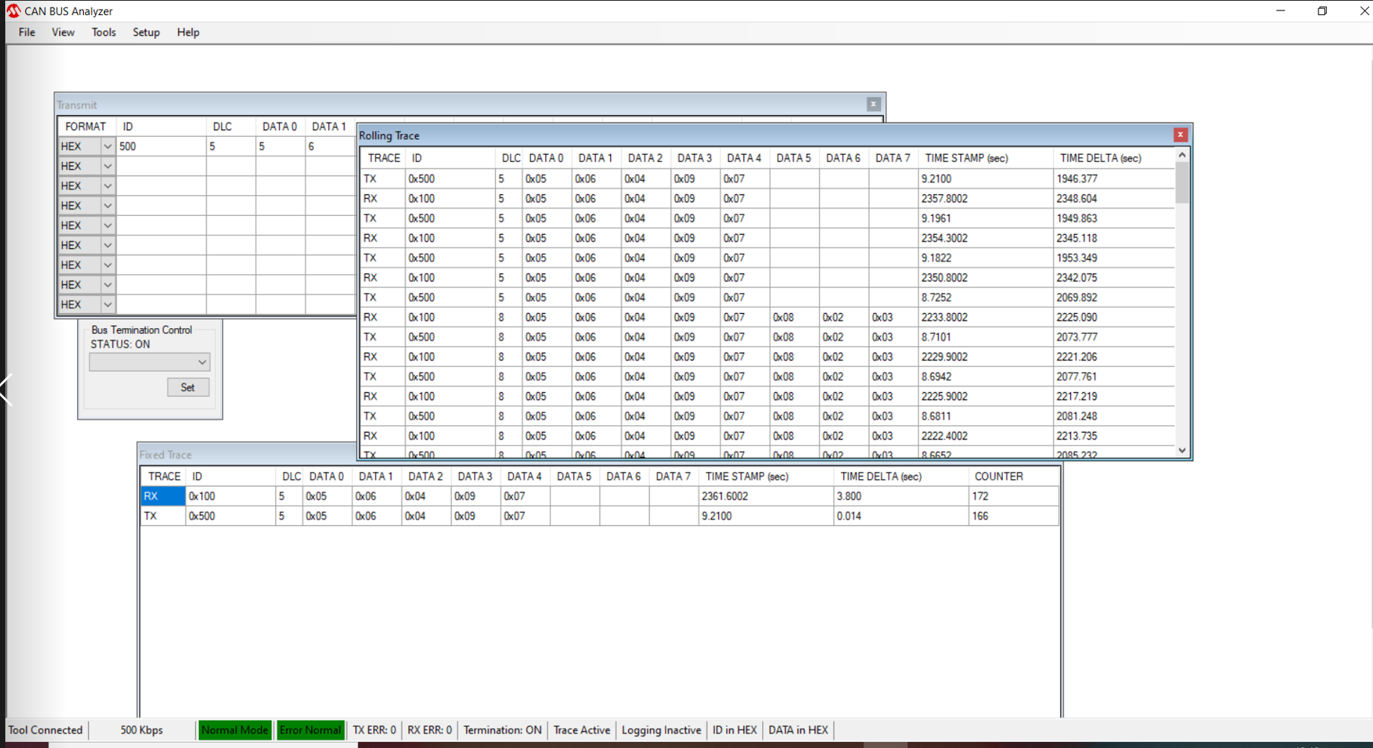
Projects
CAN Driver:
CAN driver development for microchip dpsic33ev256gm106 at 500 KBPS
Transmit of CAN messages at 1sec periodicity.
Reception of the CAN messages.
Loop Back of CAN Messages, transmitting the CAN messages received from the CAN tool.
The CAN tool used is Microchip CAN Bus analyser. The MCU is the MCLV-2 board.
MCLV-2 Board
CAN Bus Analyzer
CAN 500 KBPS

Slide 13
Projects
Throttle percentage and Vehicle speed display on the LCD
Accelerator pedal display on the LCD using UDS commands.
Vehicle speed display on the LCD using UDS commands.
C code is developed to transmit CAN tx UDS commands.
The accelerator pedal position and vehicle speed is received from the CAR
The received accelerator pedal percentage and speed displayed on LCD.
STM32 micro controller is used for this project.

Slide 14
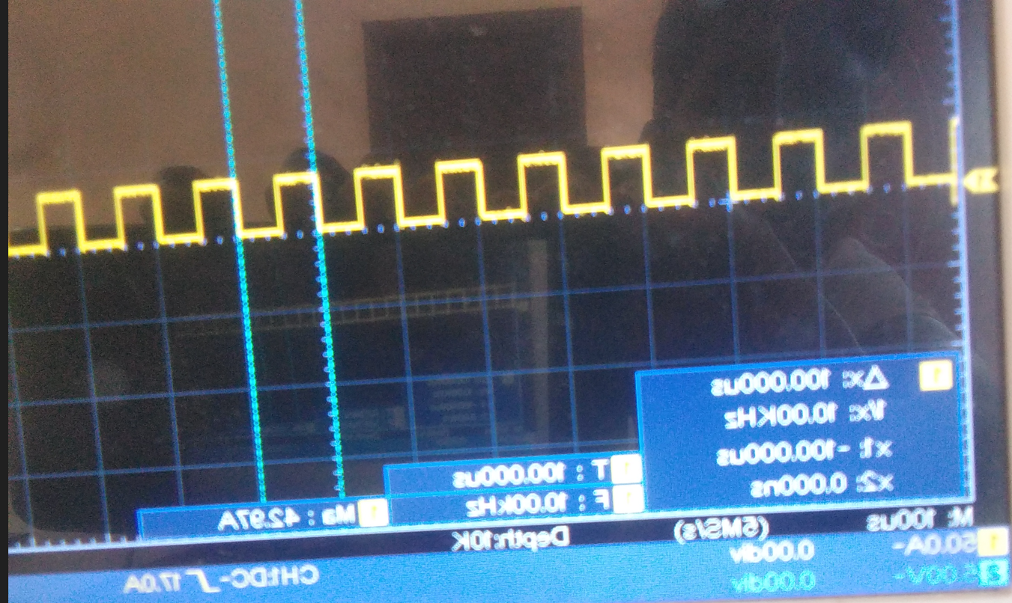
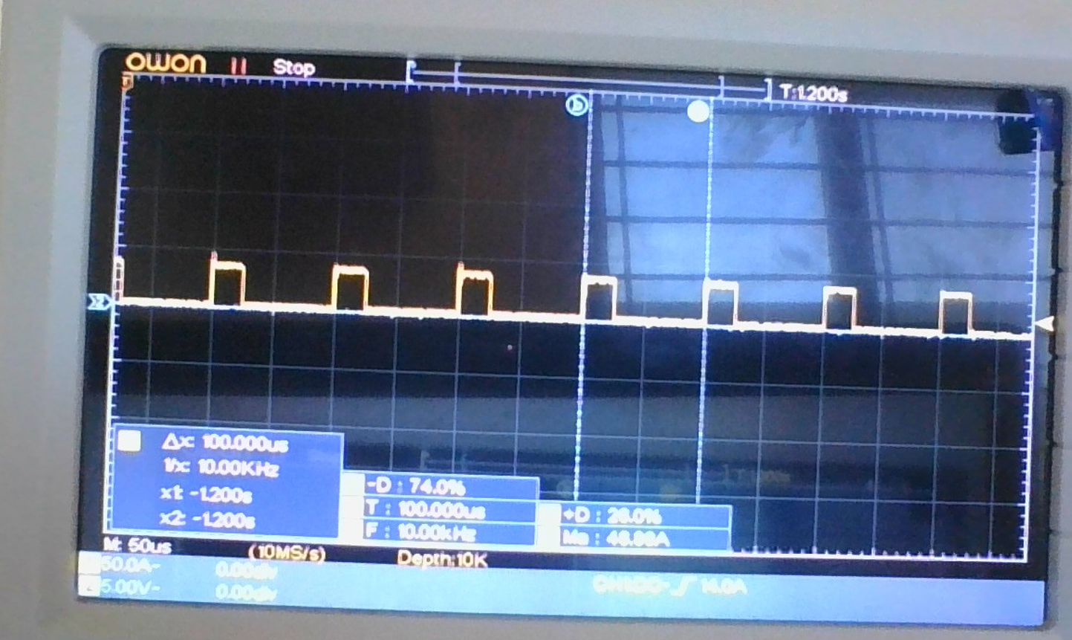
Projects
PWM Driver Development:
The PWM is configured for 10Khz for motor driving in centre aligned mode.
Total of 6 PWMs are driven and different duty settings based on the CAN command.
PWM1H, PWM1L, PWM2H, PWM2L, PWM3H, PWM3L are the pwm channels.
If the CAN command requests 50% duty cycle, the board is configured for that duty.
Other driver development like Digital Input, Analog InputOutput are completed.

Slide 15
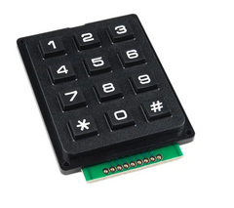
Projects
LCD and Hex KeyPad Interfacing:
Interfaced the hex key pad and LCD display with PIC microcontroller.
The project is to display the key pressed on the LCD.
The LCD used is 16*2 Character display.

Slide 16
Q & A
Thank You

